Slide 1

PC tool for easy commissioning of new electronic boards

Slide 2
Introduction
Whenever a new board comes from the production it is to be commissioned before it is ready to use for the actual task.
Commissioning of the new board includes :
Test for reading voltage, current, sensor outputs.
Testing interrupt handling capabilities.
Testing communication interfaces (UART, SPI, I2C,…….)
So, every time when there is a change in the board peripherals the code should be rewritten.
Or when there is a change in µ-controller. The code has to be rewritten, which is a time taking procedure.
So the idea is to develop a tool which can help is faster commissioning with minimal changes to code and user friendly.

Slide 3
Existing solutions
There are some sort of tools from almost every top named vendors to support their customers for easy and faster code generation.
They include:
HALCoGen from TI.
STM32CubeMX.
Target link.
Embedded coder from MATLAB.
But each system has its own disadvantages like abilities confined only to a single family of processors. Or, need a simulated model …..

Slide 4
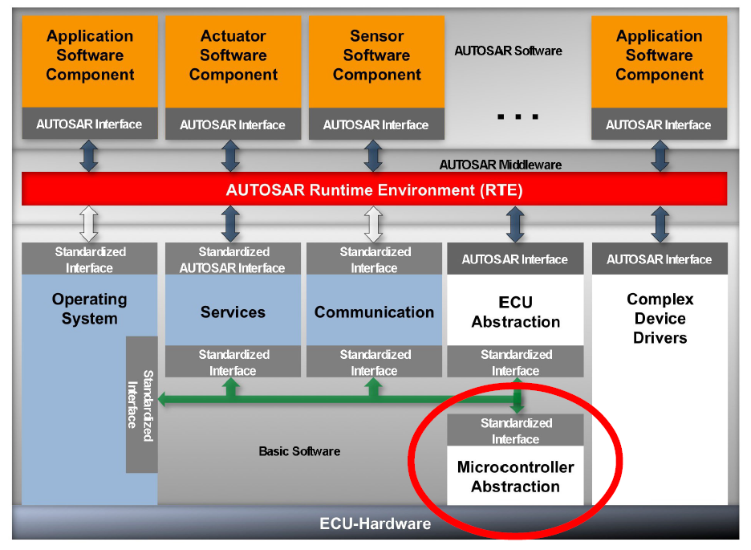
Other solutions include

Slide 5
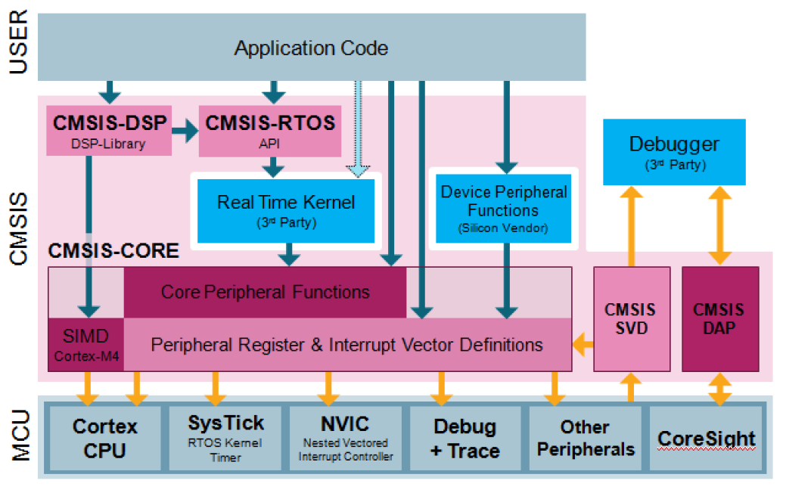
CMSIS(Cortex Microcontroller Software Interface Standards)

Slide 6
Choose microcontroller representatives.
Interface for chosen microcontroller with architecture, peripherals. To select the test components on board.
Using designed abstractions for code generation.
save the generated code on the pc.
To execute the generated code with the readily available IDE’s
Repeat and reuse ☺

Slide 7
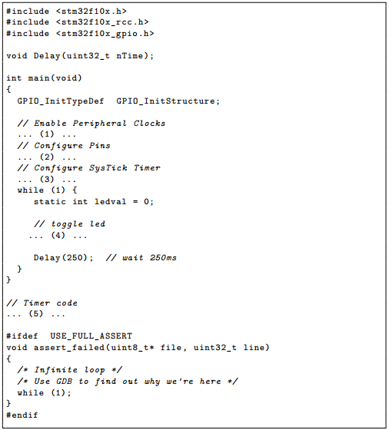
So what is the Solution
The idea is to develop an user interface to take inputs from the use and insert the user selections in a pre-configured code template.

Slide 8
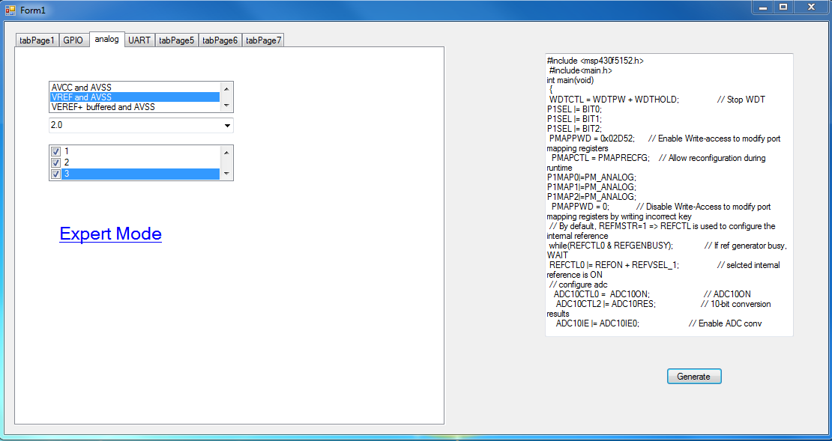
How does it look like

Slide 9
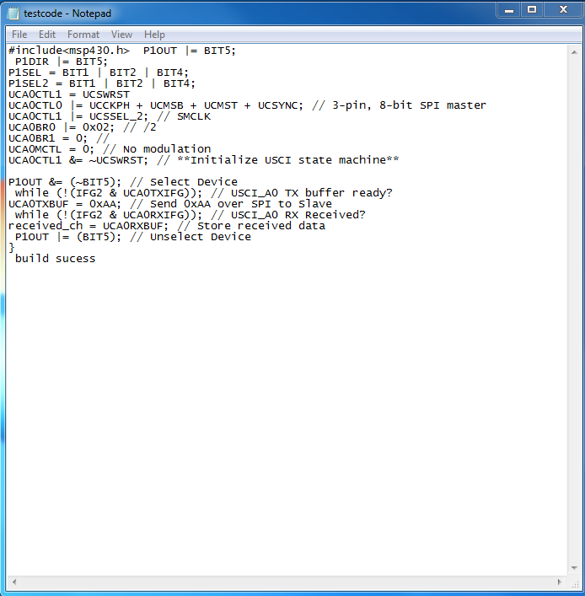
The generated .txt code can used to compile and debug from any readily available IDE’s.

Slide 10
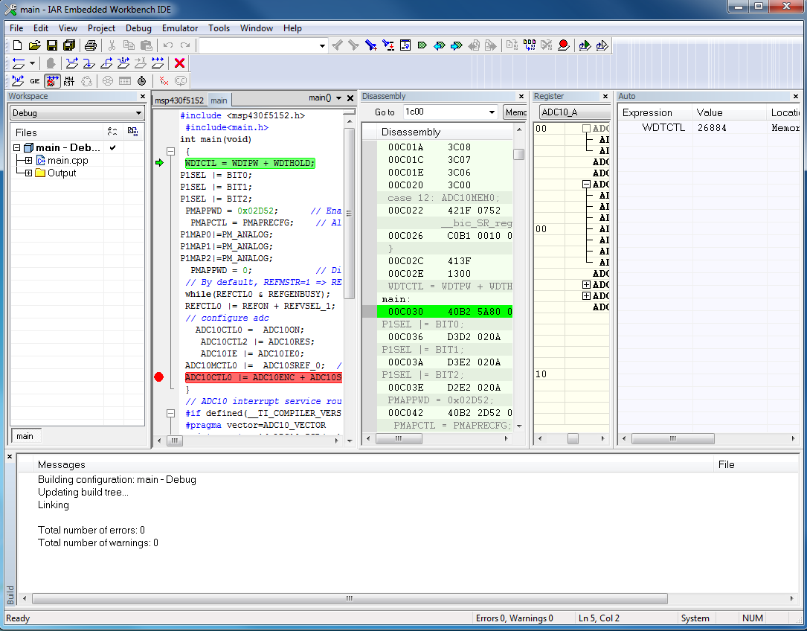
Result view page

Slide 11
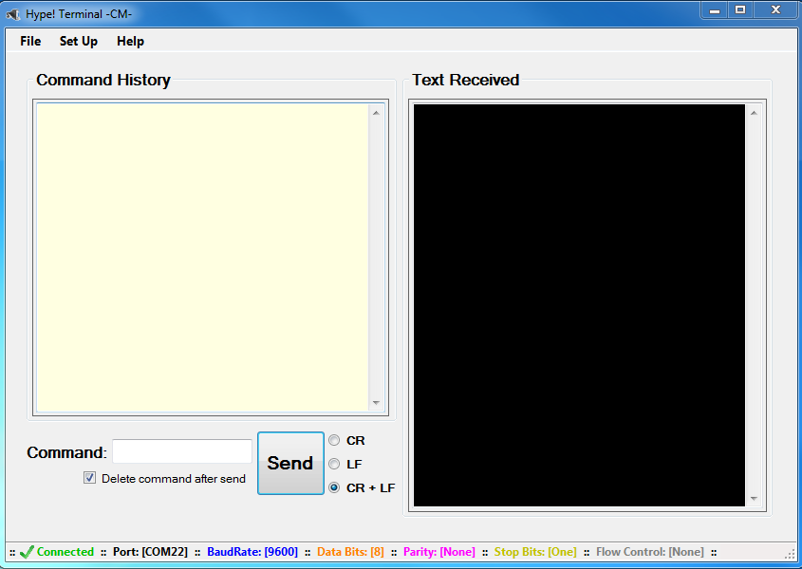
Further Improvements Planned
Need not manually open the required IDE to compile the code
The result is displayed directly using Hyper terminal.

